Slide 1


Mid Term Continuous Assessment
(Semester VI)
Vivekanand Education Society's Institute of Technology
An Autonomous Institute Affiliated to University of Mumbai
SIMULINK-RUN LENGTH CODING
Name of Guide : Mr. Mrugendra Vasmatkar
Group No.:17
1 Aditi Boob- 8(D14B)
2 Anjali Gupta- 21(D14B)
3 Neerav Sonaje- 60(D14B)
4 Aditi Ullas- 65(D14B)

Slide 2
Contents to be covered
Problem Statement
Proposed Solution
Complete Block Diagram of Proposed System
Algorithm
Observations/Results
Conclusion
References

Slide 3
Problem Statement
Design a Simulink-based simulation to implement run-length coding on a binary input signal.

Slide 4
Proposed Solution
A proposed solution for implementing run length coding (RLC) in Simulink involves designing a model that takes input data sequences and generates corresponding encoded sequences using the RLC algorithm. Here's a step-by-step approach to implementing this solution: effectively implement run length coding in Simulink and assess its performance for compressing data sequences. This approach leverages Simulink's graphical modeling capabilities and MATLAB's computational tools to create a comprehensive solution for RLC encoding and evaluation.

Slide 5
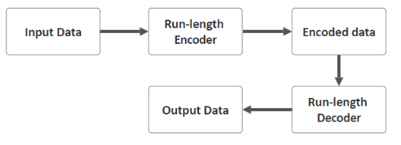
Block Diagram
Fig.1 Block Diagram of Run Length Coding

Slide 6
Input Data : This block represents the original data sequence that needs to be compressed using the RLC algorithm. It could be any type of data, such as a binary sequence, image pixels, or text characters.
Run-Length Encoder : This block is responsible for compressing the input data by identifying consecutive identical symbols and replacing them with a single symbol followed by a count of their occurrences. The encoder generates the encoded data based on this compression scheme.
Encoded Data : This block represents the compressed data output by the Run-Length Encoder. It contains the compressed representation of the input data, typically consisting of pairs of symbols and their respective counts.
Run-Length Decoder : This block performs the inverse operation of the encoder. It takes the encoded data as input and reconstructs the original data sequence by expanding the compressed representations back into their original form.
Output Data : This block represents the reconstructed or decompressed data sequence generated by the Run-Length Decoder. It ideally matches the original input data, allowing for lossless data compression and decompression using the RLC algorithm.

Slide 7
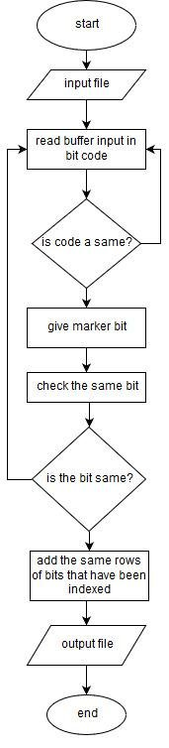
Algorithm

Slide 8
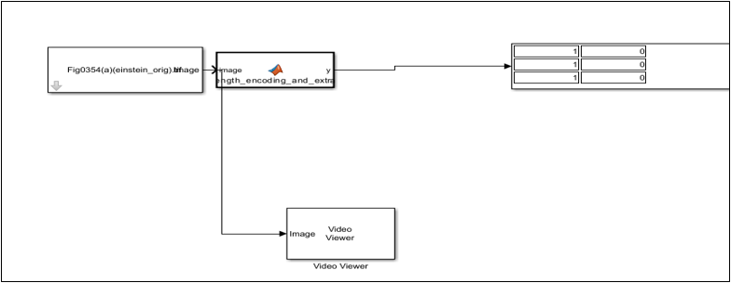
Observations / Results
Fig 3.Simulink Implementation

Slide 9
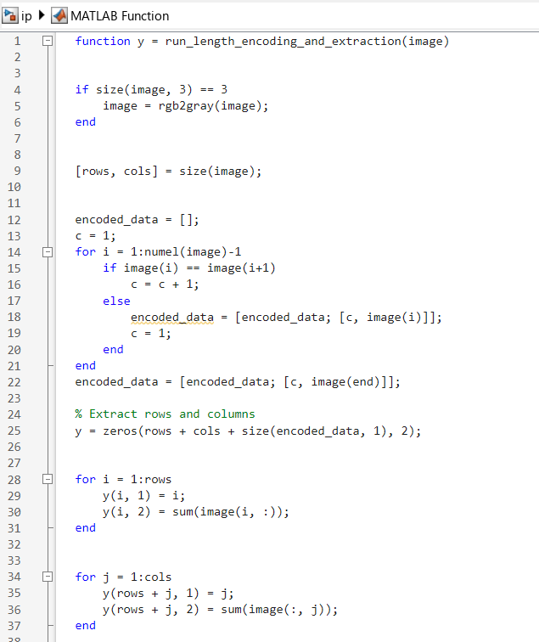
Observations / Results
Fig.2 Simulink Function Code

Slide 10
Conclusion
The Simulink-based simulation of run-length coding (RLC) reveals its effectiveness in reducing interpixel redundancy in images through horizontal or vertical scanning and grouping of pixels with the same intensity into pairs. While RLC is widely utilized in binary and two-valued images like fax standards and bitmap images, its limitations in compressing highly textured images are acknowledged.

